Slide 1
Subprime Mortgage Institution an Alternative Definition Kyle Bowman

Slide 2
Objective:
Using a newly crafted Subprime Definition; evaluate differences between standard definitions used in the from the financial crisis. Lastly, using two of the definitions assess the number of Subprime originations between 2008 and 2016.
The Subprime Definitions
HMDA Higher Priced
Uses the interest rate given to the borrower in terms of the treasury standards
Higher sensitivity to the economic environment, especially the Federal Funds Rate
Higher interest rates reflects more risk, which is why the loan is priced higher
HUD Subprime
Evaluated lending institutions by calling and asking if they were heavy in subprime lending
Ceased to produce this definition after 2005
Subprime Institution
Uses a list of institutions that failed/went bankrupt during the financial crisis

Slide 3
Why Is This Research Important???
The ability to identify riskier loans is critical for the health of housing market
A healthy housing market provides stability to the economy
Policy/Oversight/Government Regulation need be evaluated to ensure lending standards are not diluted
This work is intended to compare subprime definitions and offer a new vantage point
There is no universal defined definition for subprime that can be used at the macro level
Subprime definitions are hard to define (buy outs, sold loans)

Slide 4
Subprime Unit Counts Cross Tabulation
Data is between 2004 and 2007 with total units evaluated was 55 million
The table below reflects a cross tabulation between subprime definitions.
“All” represents when all three definitions categorize as subprime, with the row totals being actual number of Subprime units.

Slide 5
Predictors for the Subprime Institution Model
Variable | Definition
Sold To | Lending institutions originated and sold to another investor, such as a Commercial Bank, Government Sponsored Entity (GSE), Private Security
Purpose | Refinance Mortgage versus Home Purchase Mortgage
Race | Borrower’s Race
Sex | Borrower’s Sex
Pre-Approval | Pre-Approval was requested for the loan at origination
Lien Position | First Lien or Not First Lien
Income Quintile | Borrowers stated income differenced from the State median stated income. Quintile 5 indicates low income to the State median.

Slide 6
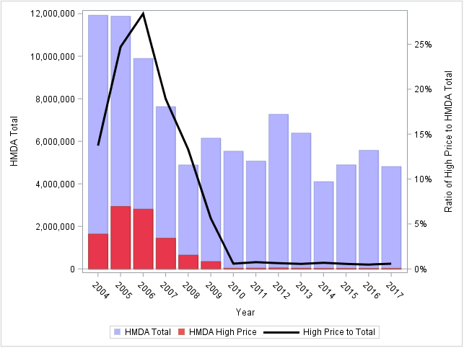
Population Characteristics (HMDA High Priced)
Ratio of High Priced Subprime to Total Originations
Lending Changes
Structural Break

Slide 7
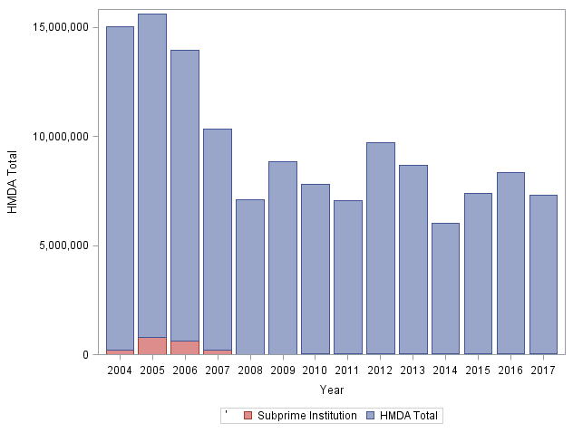
Population Characteristics (Subprime Institution)
Predicted Loans
Total Loans

Slide 8
Main Results
2004 to 2007:
Subprime Institution definition is half that of Higher Priced
The predictive accuracy using the Subprime Institution definition is questionable
2008 Forward:
Both, Subprime Institution and Higher Priced show a dramatic reduction in Subprime loans
The Loan Application Registrar (LARs) data shows tightening of lending standards
Shift of originations being sold to Government Sponsored Entities

Slide 9
Main Results
Originations being sold to Private Securities disappeared after 2007. This is likely due to the cease in mortgage backed securities post the financial crisis.
A considerable shift between pre/post financial crisis to the GSE’s.

Slide 10
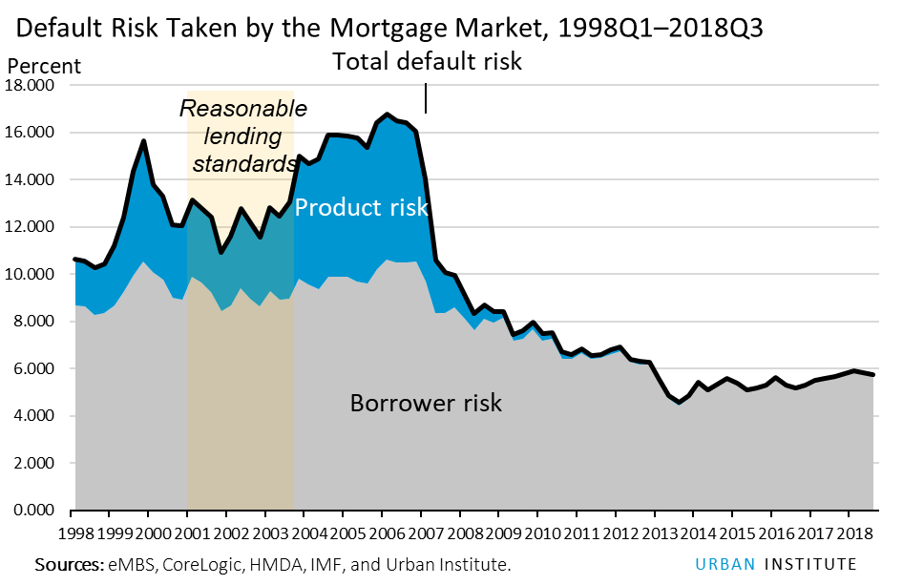
Where Did the Subprime Loans Go???
Higher Rate of Riskier Products and Borrower Risk
Before Great Recession
After Great Recession
https://www.urban.org/sites/default/files/publication/98669/housing_finance_at_a_glance_a_monthly_chartbook_june_2018_0.pdf

Slide 11
Conclusion
2004 to 2007:
Lending standards were loose
Second lien loans consumed a higher percentage of the population
More loans were sold to securities
2008 Forward:
Lending standards tightened
Refinance boom occurred due to lower rate environment
Considerable amount of originations shifted to GSE

Slide 12
Appendix (Simple Stats)

Slide 13
Appendix (Simple Stats)

Slide 14
Appendix (Simple Stats)

Slide 15
Appendix (Simple Stats)

Slide 16
Appendix (Model Results)

Slide 17
Appendix (Model Results)

Slide 18
Appendix (Model Results)

Slide 19
Appendix (Model Results)

